Slide 1
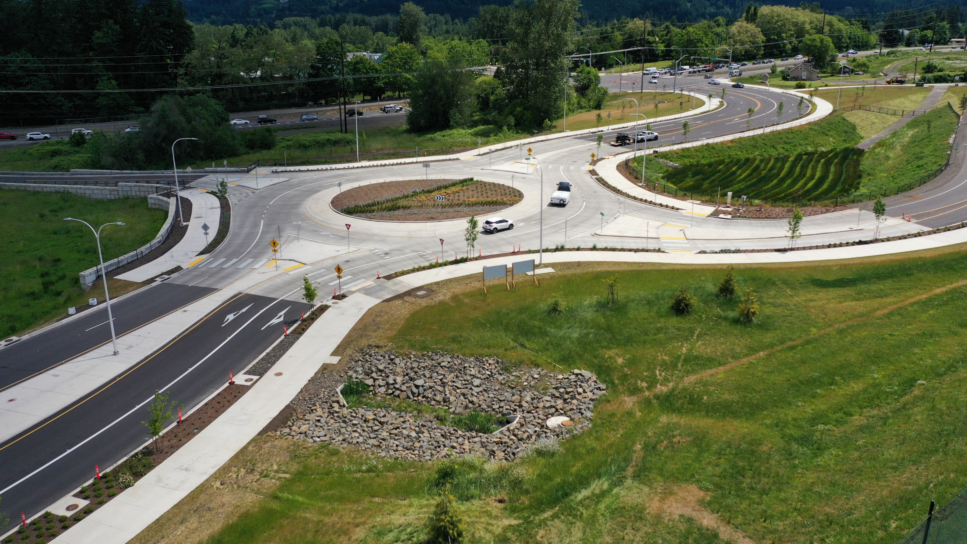






Sherwood
Hwy 99W Pedestrian Bridge Project
Sherwood City Council Work Session
April 19, 2022

Slide 2
Meeting Goals:
Provide update to City Council on progress made and solicit input selection of a preferred alternative for further development.
Agenda:
  Online Open House #2 Survey Results
  High School View Impacts
  Alternatives Analysis
  Action Needed
City of Sherwood
Hwy 99W Pedestrian Bridge Project
HWY 99W PEDESTRIAN BRIDGE PROJECT | AGENDA

Slide 3
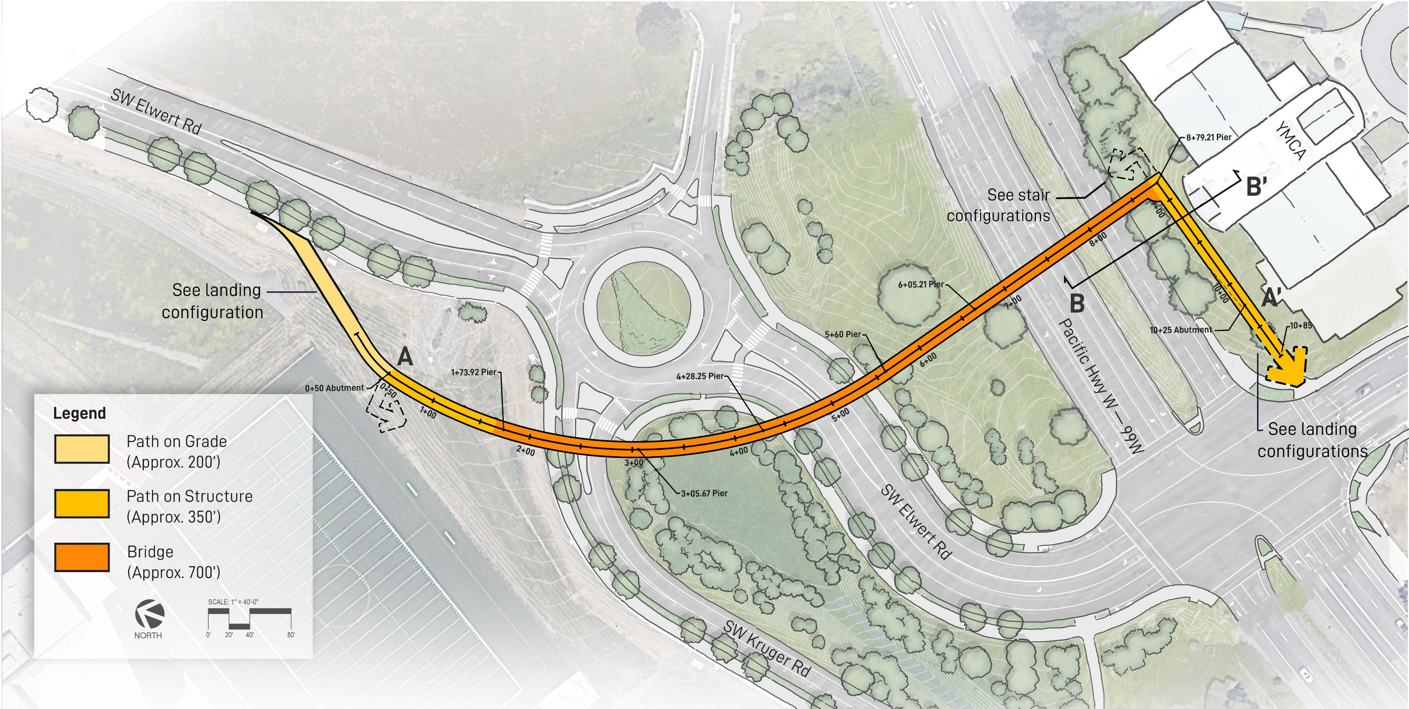
Online Open House #2 Survey Results
287 views and 58 survey participants.
Alignment: Participants showed general support for the selected alignment and landings.
City of Sherwood
Hwy 99W Pedestrian Bridge Project
Preferred Alignment – Option A2
HWY 99W PEDESTRIAN BRIDGE PROJECT | ONLINE SURVEY RESULTS

Slide 4
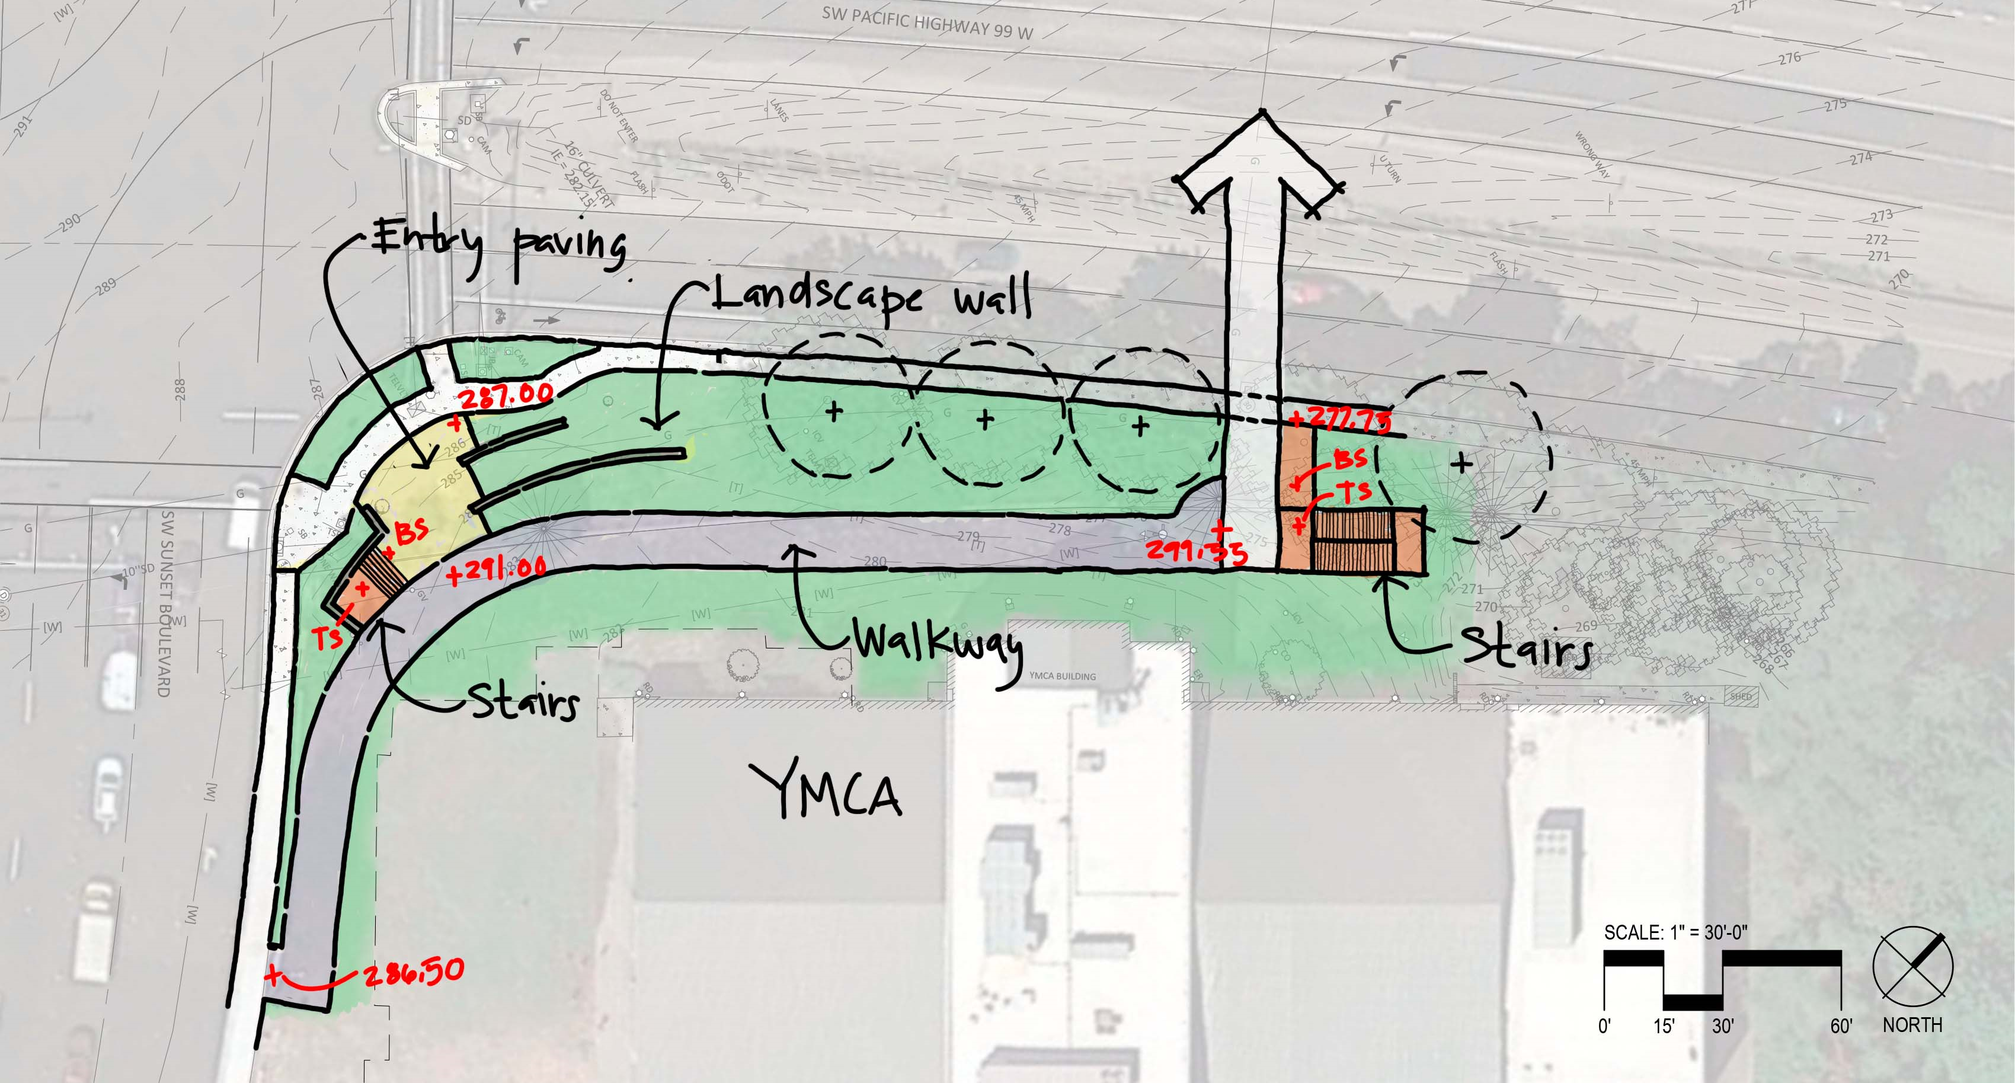
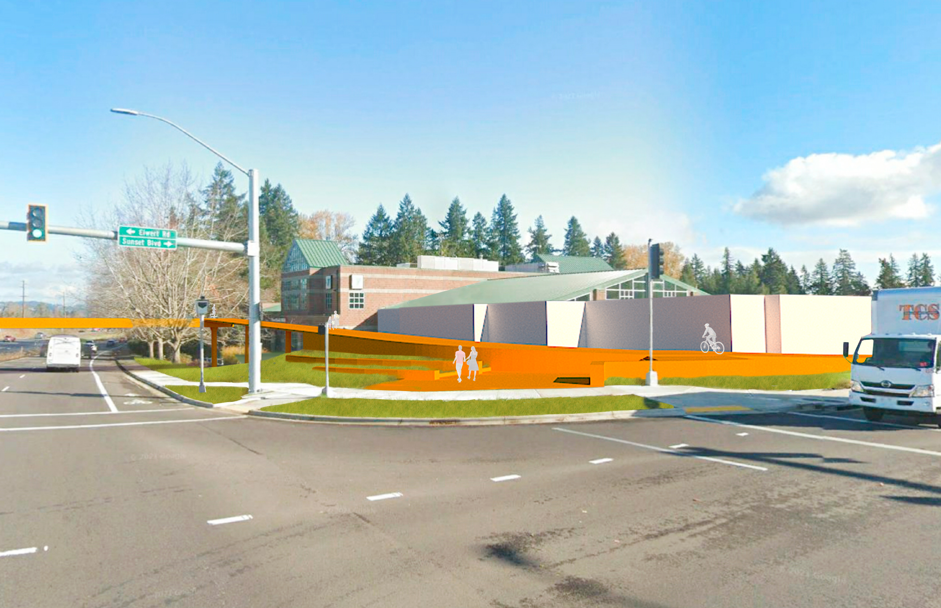
Massing Perspective
Plan View
City of Sherwood
Hwy 99W Pedestrian Bridge Project
HWY 99W PEDESTRIAN BRIDGE PROJECT
HWY 99W PEDESTRIAN BRIDGE PROJECT | Alignment A2 –East Landing – Option 2

Slide 5
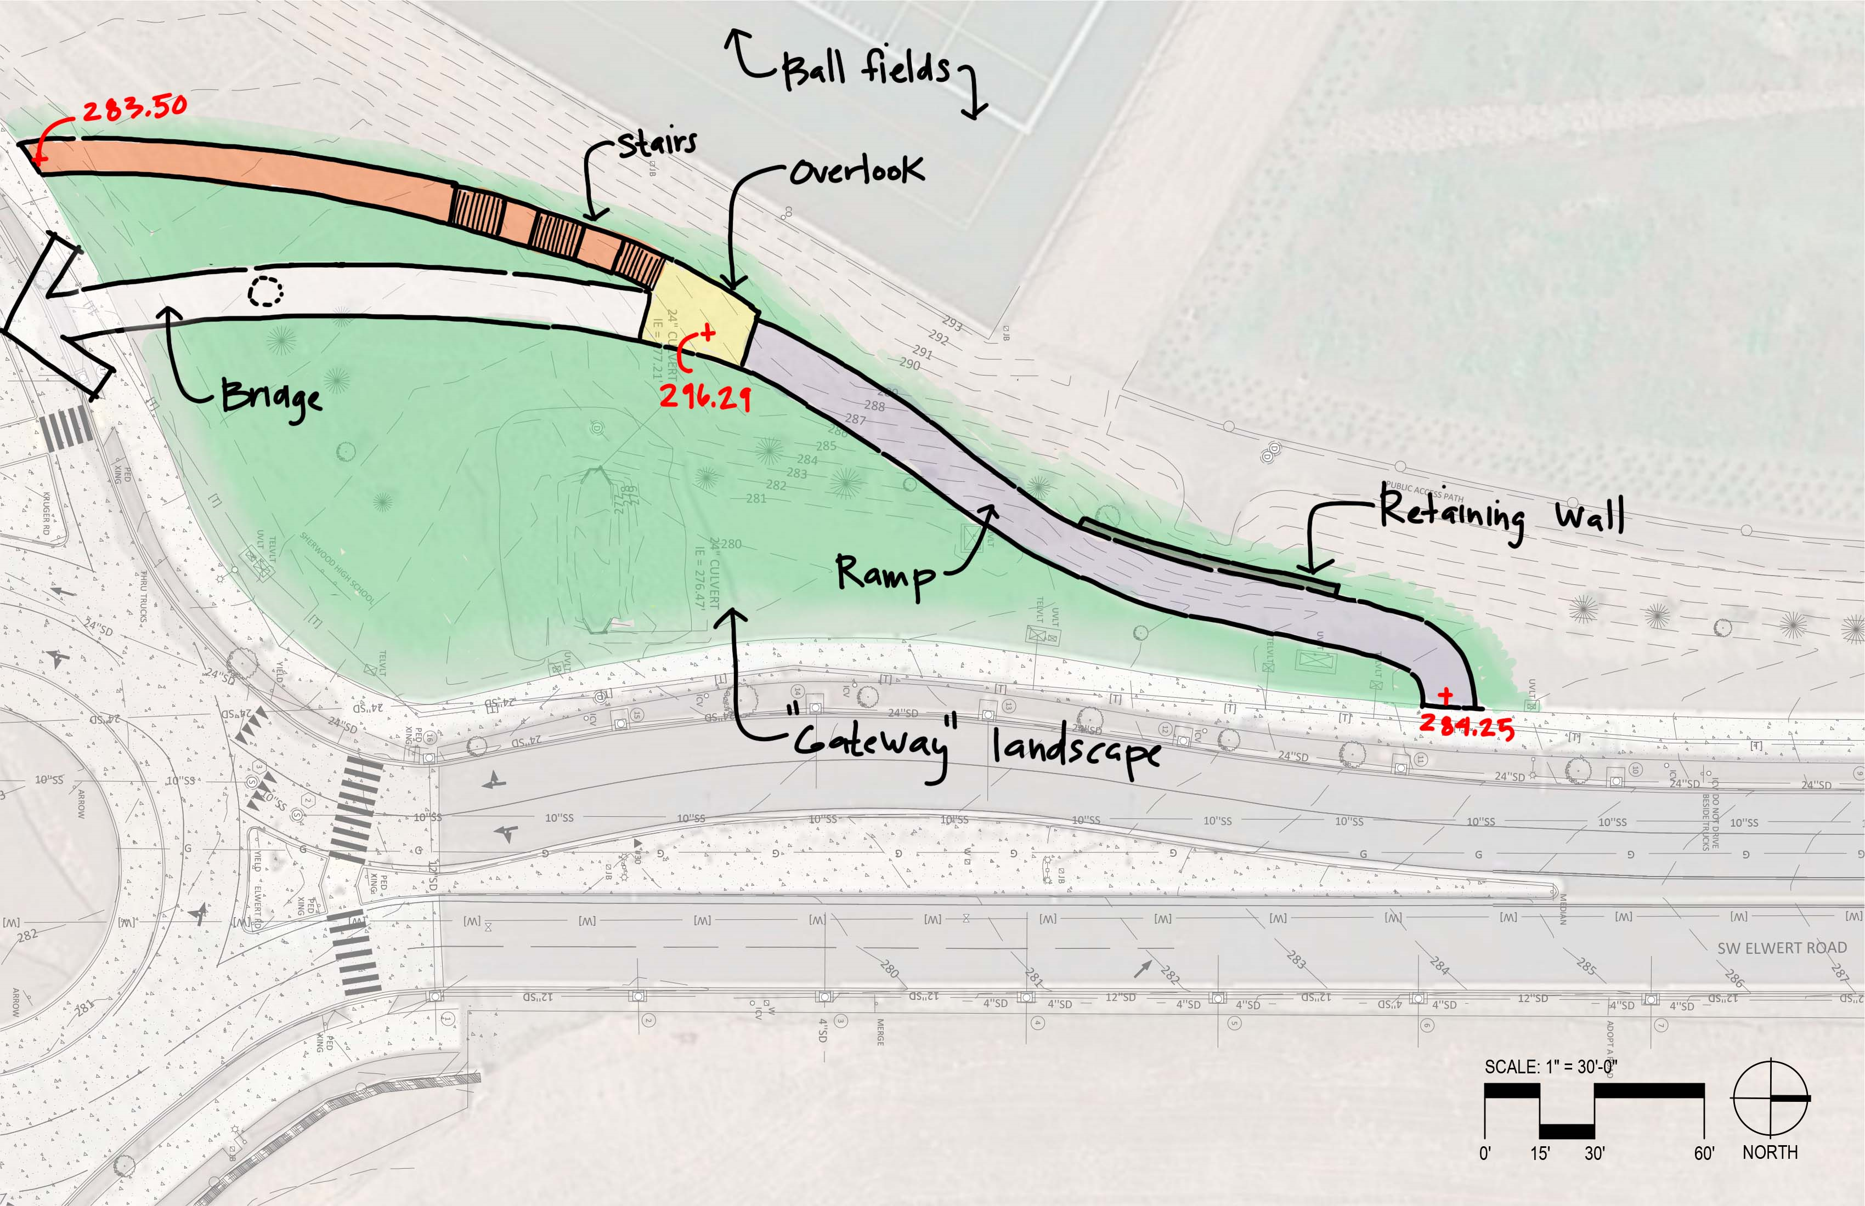
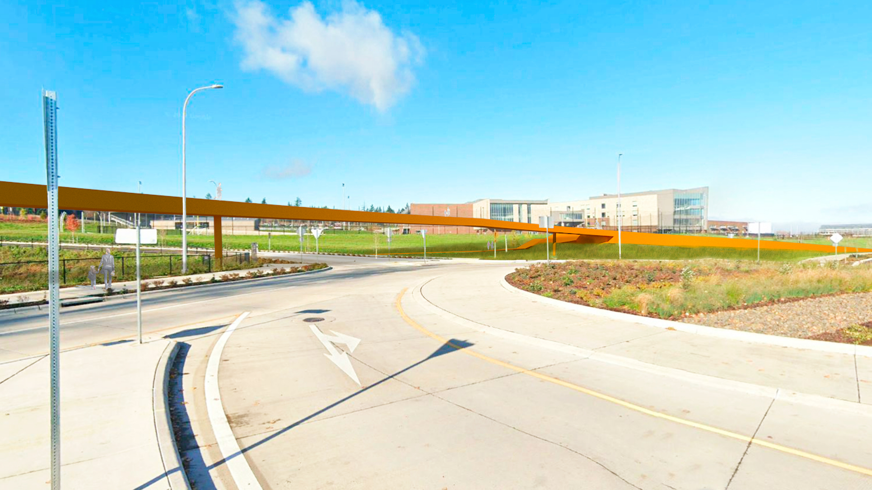
Massing Perspective
Plan View
City of Sherwood
Hwy 99W Pedestrian Bridge Project
HWY 99W PEDESTRIAN BRIDGE PROJECT
HWY 99W PEDESTRIAN BRIDGE PROJECT | Alignment A2 –West Landing

Slide 6
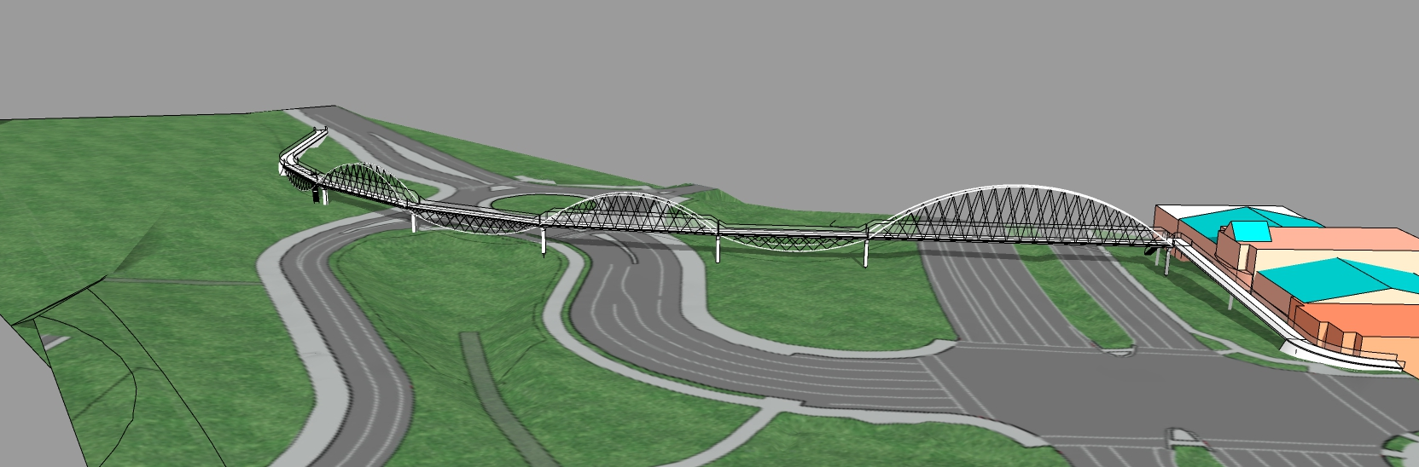

Online Open House #2 Survey Results
Structure Type
High Arches Alternating with Inverted Arch Truss
City of Sherwood
Hwy 99W Pedestrian Bridge Project
Alternating Upright and Inverted Bowstring Trusses
HWY 99W PEDESTRIAN BRIDGE PROJECT | ONLINE SURVEY RESULTS

Slide 7
Online Open House #2 Survey Results
Structure Type
62% chose the Tall Arch option as their favorite option.
28% chose Bowstring Truss as their favorite option
Both Tall Arch and Bowstring Truss were chosen as first or second favorite option by 80% of the respondents
63% chose the Tall Arch with Twin Girders approach option as their least favorite option
Participants strongly preferred a steel bridge (75%) to a wood bridge (13%)
City of Sherwood
Hwy 99W Pedestrian Bridge Project
HWY 99W PEDESTRIAN BRIDGE PROJECT | ONLINE SURVEY RESULTS

Slide 8
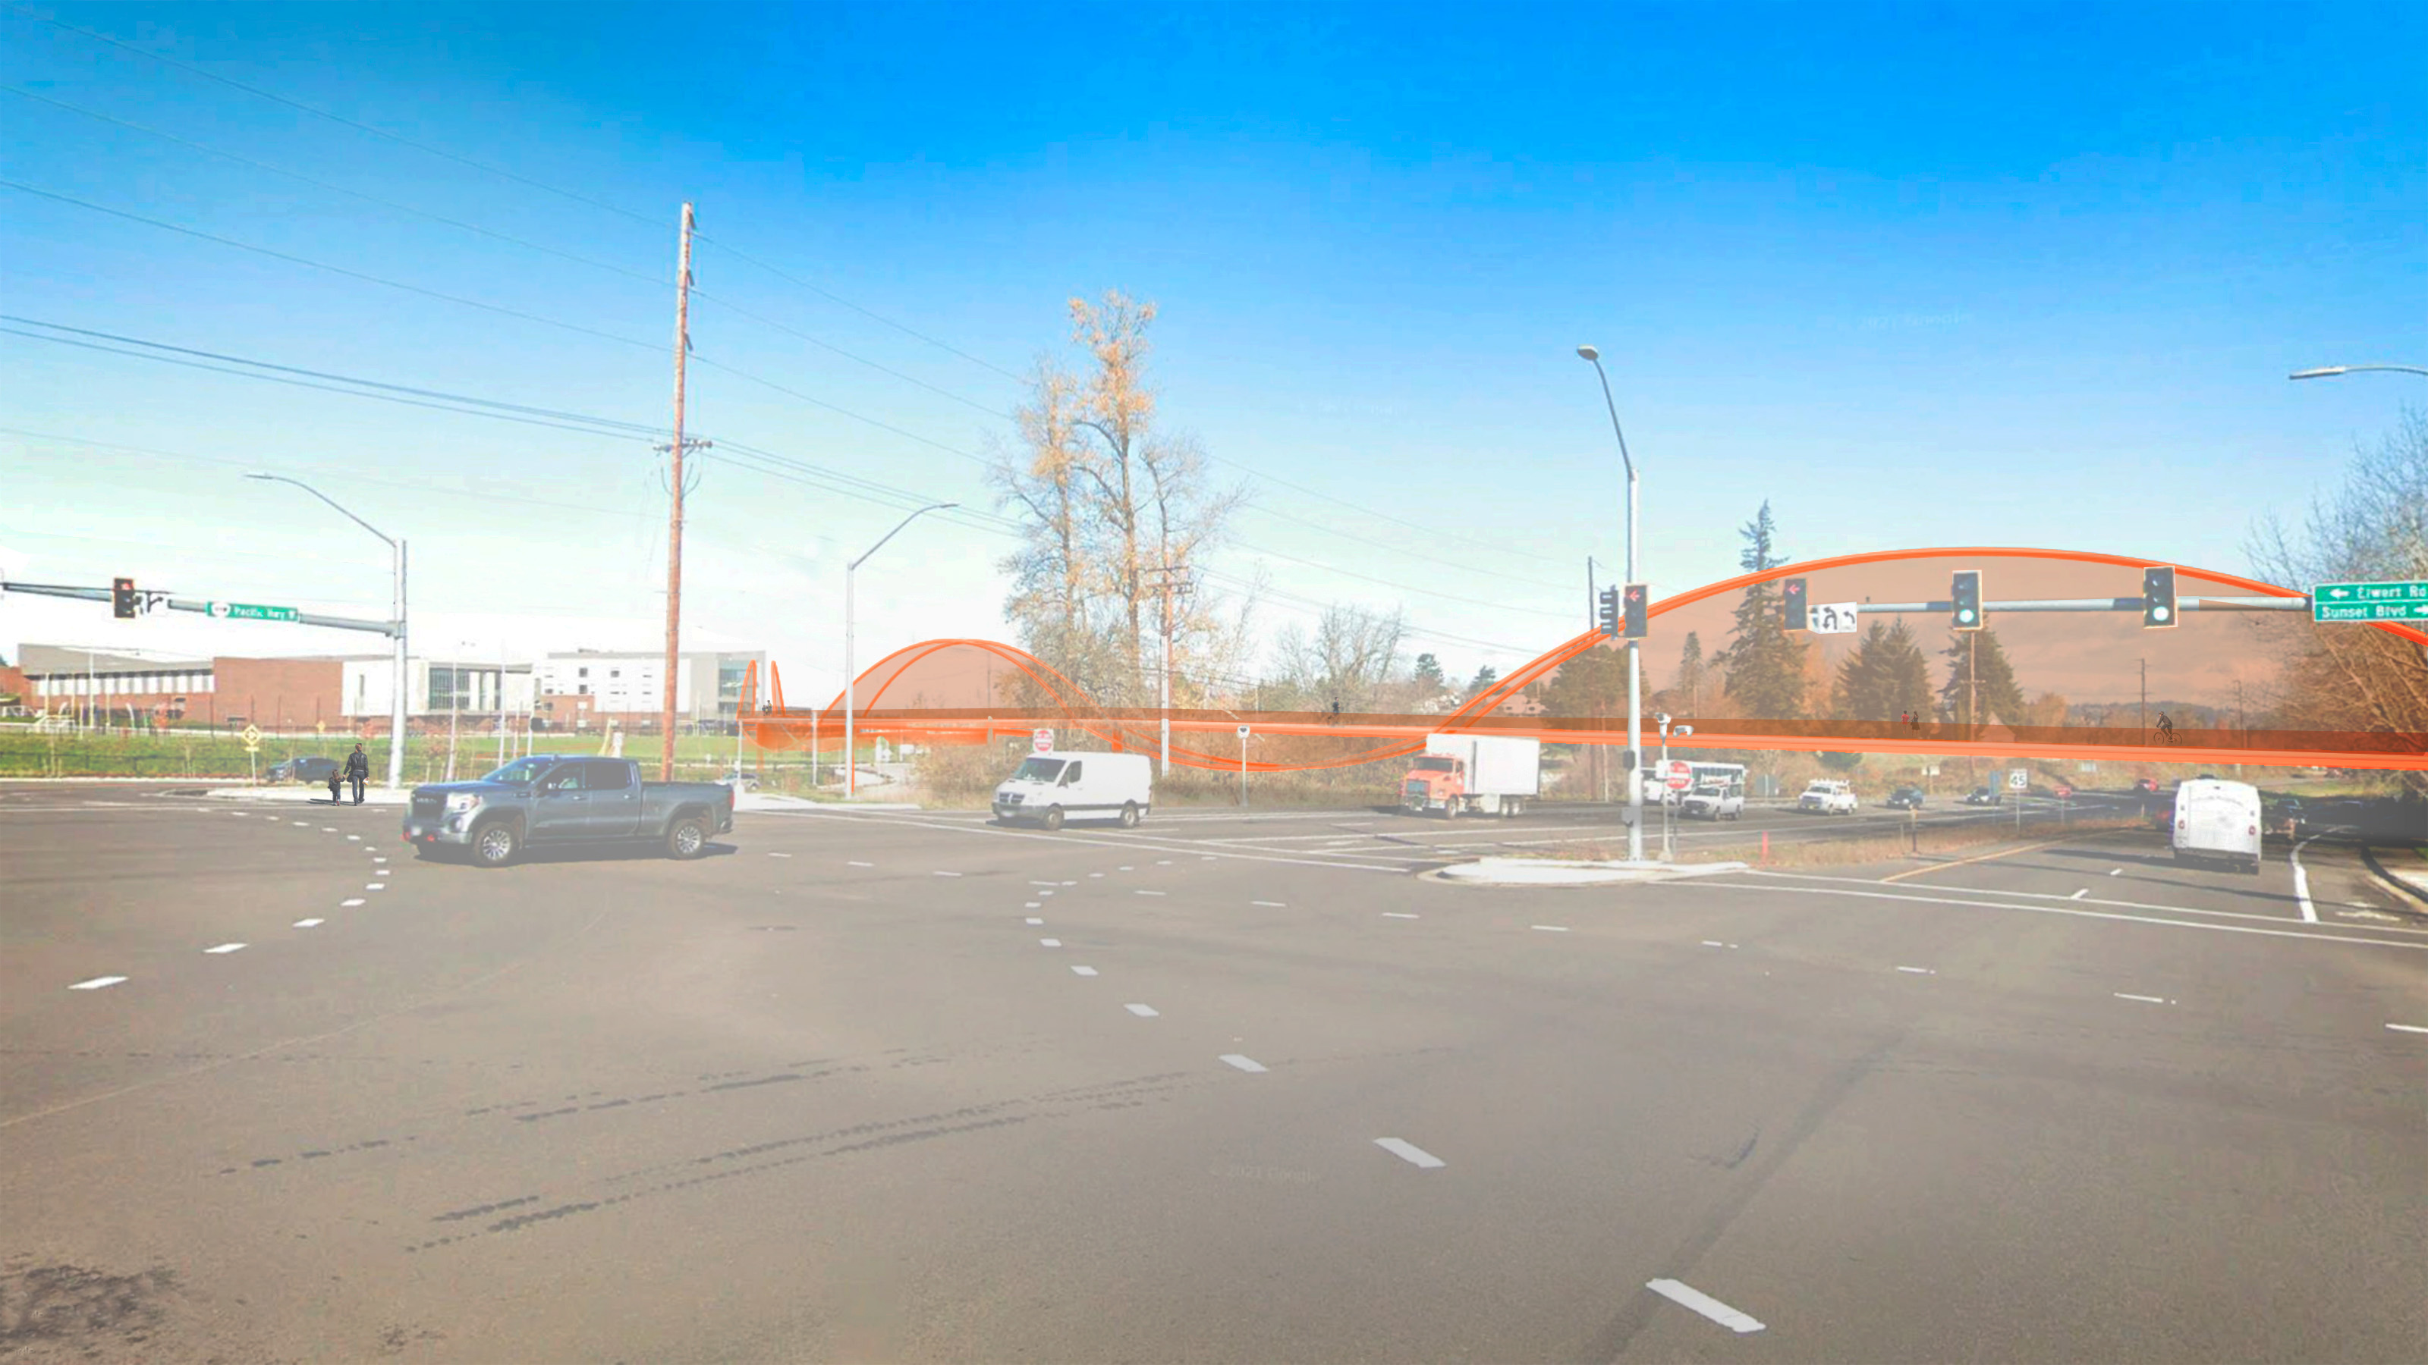
High School Visual Impacts
City of Sherwood
Hwy 99W Pedestrian Bridge Project
View of High School from northbound Hwy 99W at SW Sunset Blvd intersection.
HWY 99W PEDESTRIAN BRIDGE PROJECT | High School Visual Impacts

Slide 9
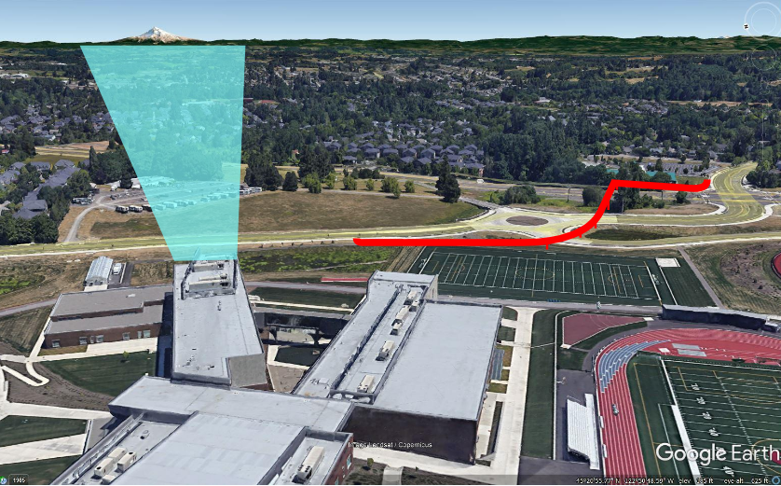
High School Visual Impacts
City of Sherwood
Hwy 99W Pedestrian Bridge Project
View of Mt Hood from Sherwood High School
HWY 99W PEDESTRIAN BRIDGE PROJECT | High School Visual Impacts

Slide 10
Alternatives Analysis Matrix
Goals | Alignment A2
 | Bridge Type
 | Tall Arch Main Span / Arch Approaches | Bowstring Truss Main Span and Approaches | Bowstring Truss Main Span and Approaches | Tall Arch Main Span / Twin Girder Approaches
Safety Improvement | The alignment eliminates all pedestrian crossing conflicts between Hwy 99W and SHS.
Connectivity | The alignment provides direct connection between the YMCA, SHS, and the multiuse trail on SW Elwert Rd and SW Kruger Rd.
Accessibility | All approaches to meet ADA.
Desirability | Most direct route (1280' total route length).
Utility Impacts | Overhead utility line adjustments and coordination with utilities required.
Environmental Impacts | Moderate potential for wetland and/or vegetated corridor impacts.
Signature Structure Potential | High (Bridge would be unique to Sherwood) |  |  | Moderate (Similar bridges in NW)
Gateway Design Potential | All alternative structure types allow for a high gateway design potential.
ROM Construction Cost | $13M |  | $14M | $13M
City of Sherwood
Hwy 99W Pedestrian Bridge Project
HWY 99W PEDESTRIAN BRIDGE PROJECT | Alternatives Analysis

Slide 11
Action Needed
Confirm selection of preferred alternatives for alignment, structure type and structure material or indicate additional information needed.
  Alignment Option A2 with East Landing Option 2 identified as preferred alignment at previous Council work session.
  Preferred Structure Type
    High Arches Alternating with Inverted Arch Truss
    Alternating Upright and Inverted Bowstring Trusses
    High Arch Main Span with Twin Girder Approach
  Structure Material Type
    Steel identified as preferred at prior Council session and preferred by survey respondents.
City of Sherwood
Hwy 99W Pedestrian Bridge Project
HWY 99W PEDESTRIAN BRIDGE PROJECT | Action Needed

Slide 12
Next Steps:
Complete 30% Design / Cost Estimating – 6/20
City of Sherwood
Hwy 99W Pedestrian Bridge Project
HWY 99W PEDESTRIAN BRIDGE PROJECT | Next Steps

